Slide 1
Kubernetes cluster interaction simplified with k9s
Arka Bhattacharya
#ossummit
@findarka

Slide 2




$whoami
Senior Consultant @ Solo.io
@findarka
linkedin.com/in/findarka
Arka Bhattacharya​

Slide 3
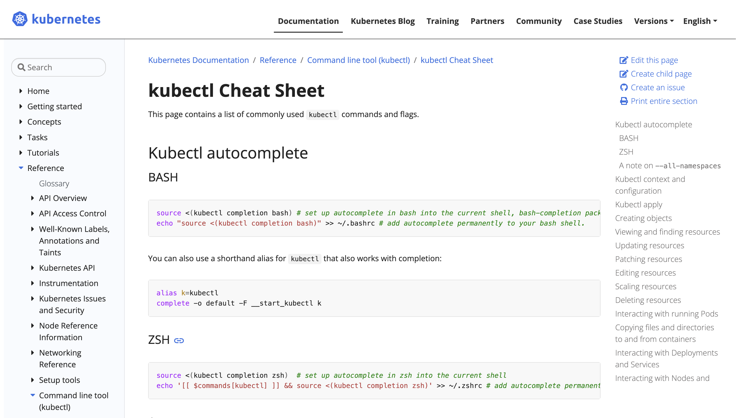
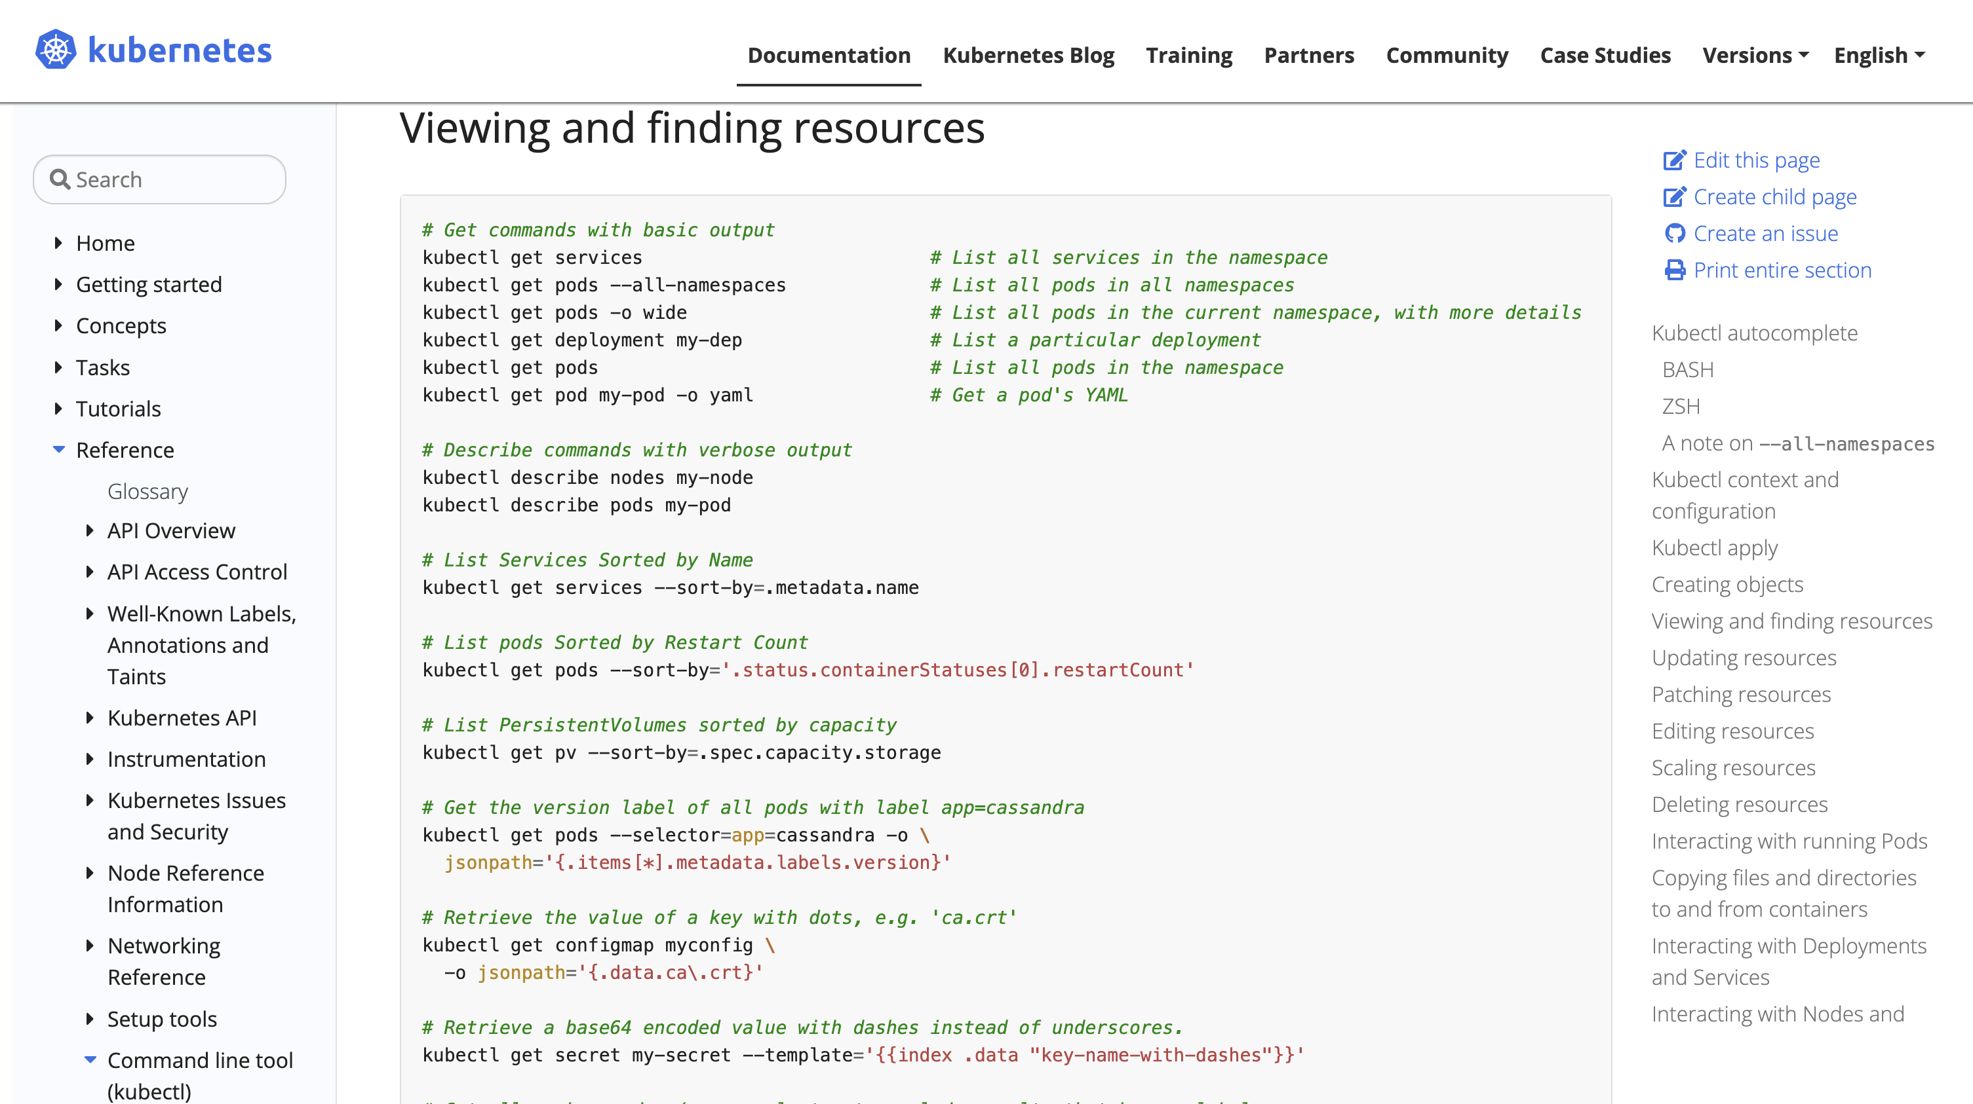
It all started with kubectl get pods
kubectl Cheat Sheet link

Slide 4
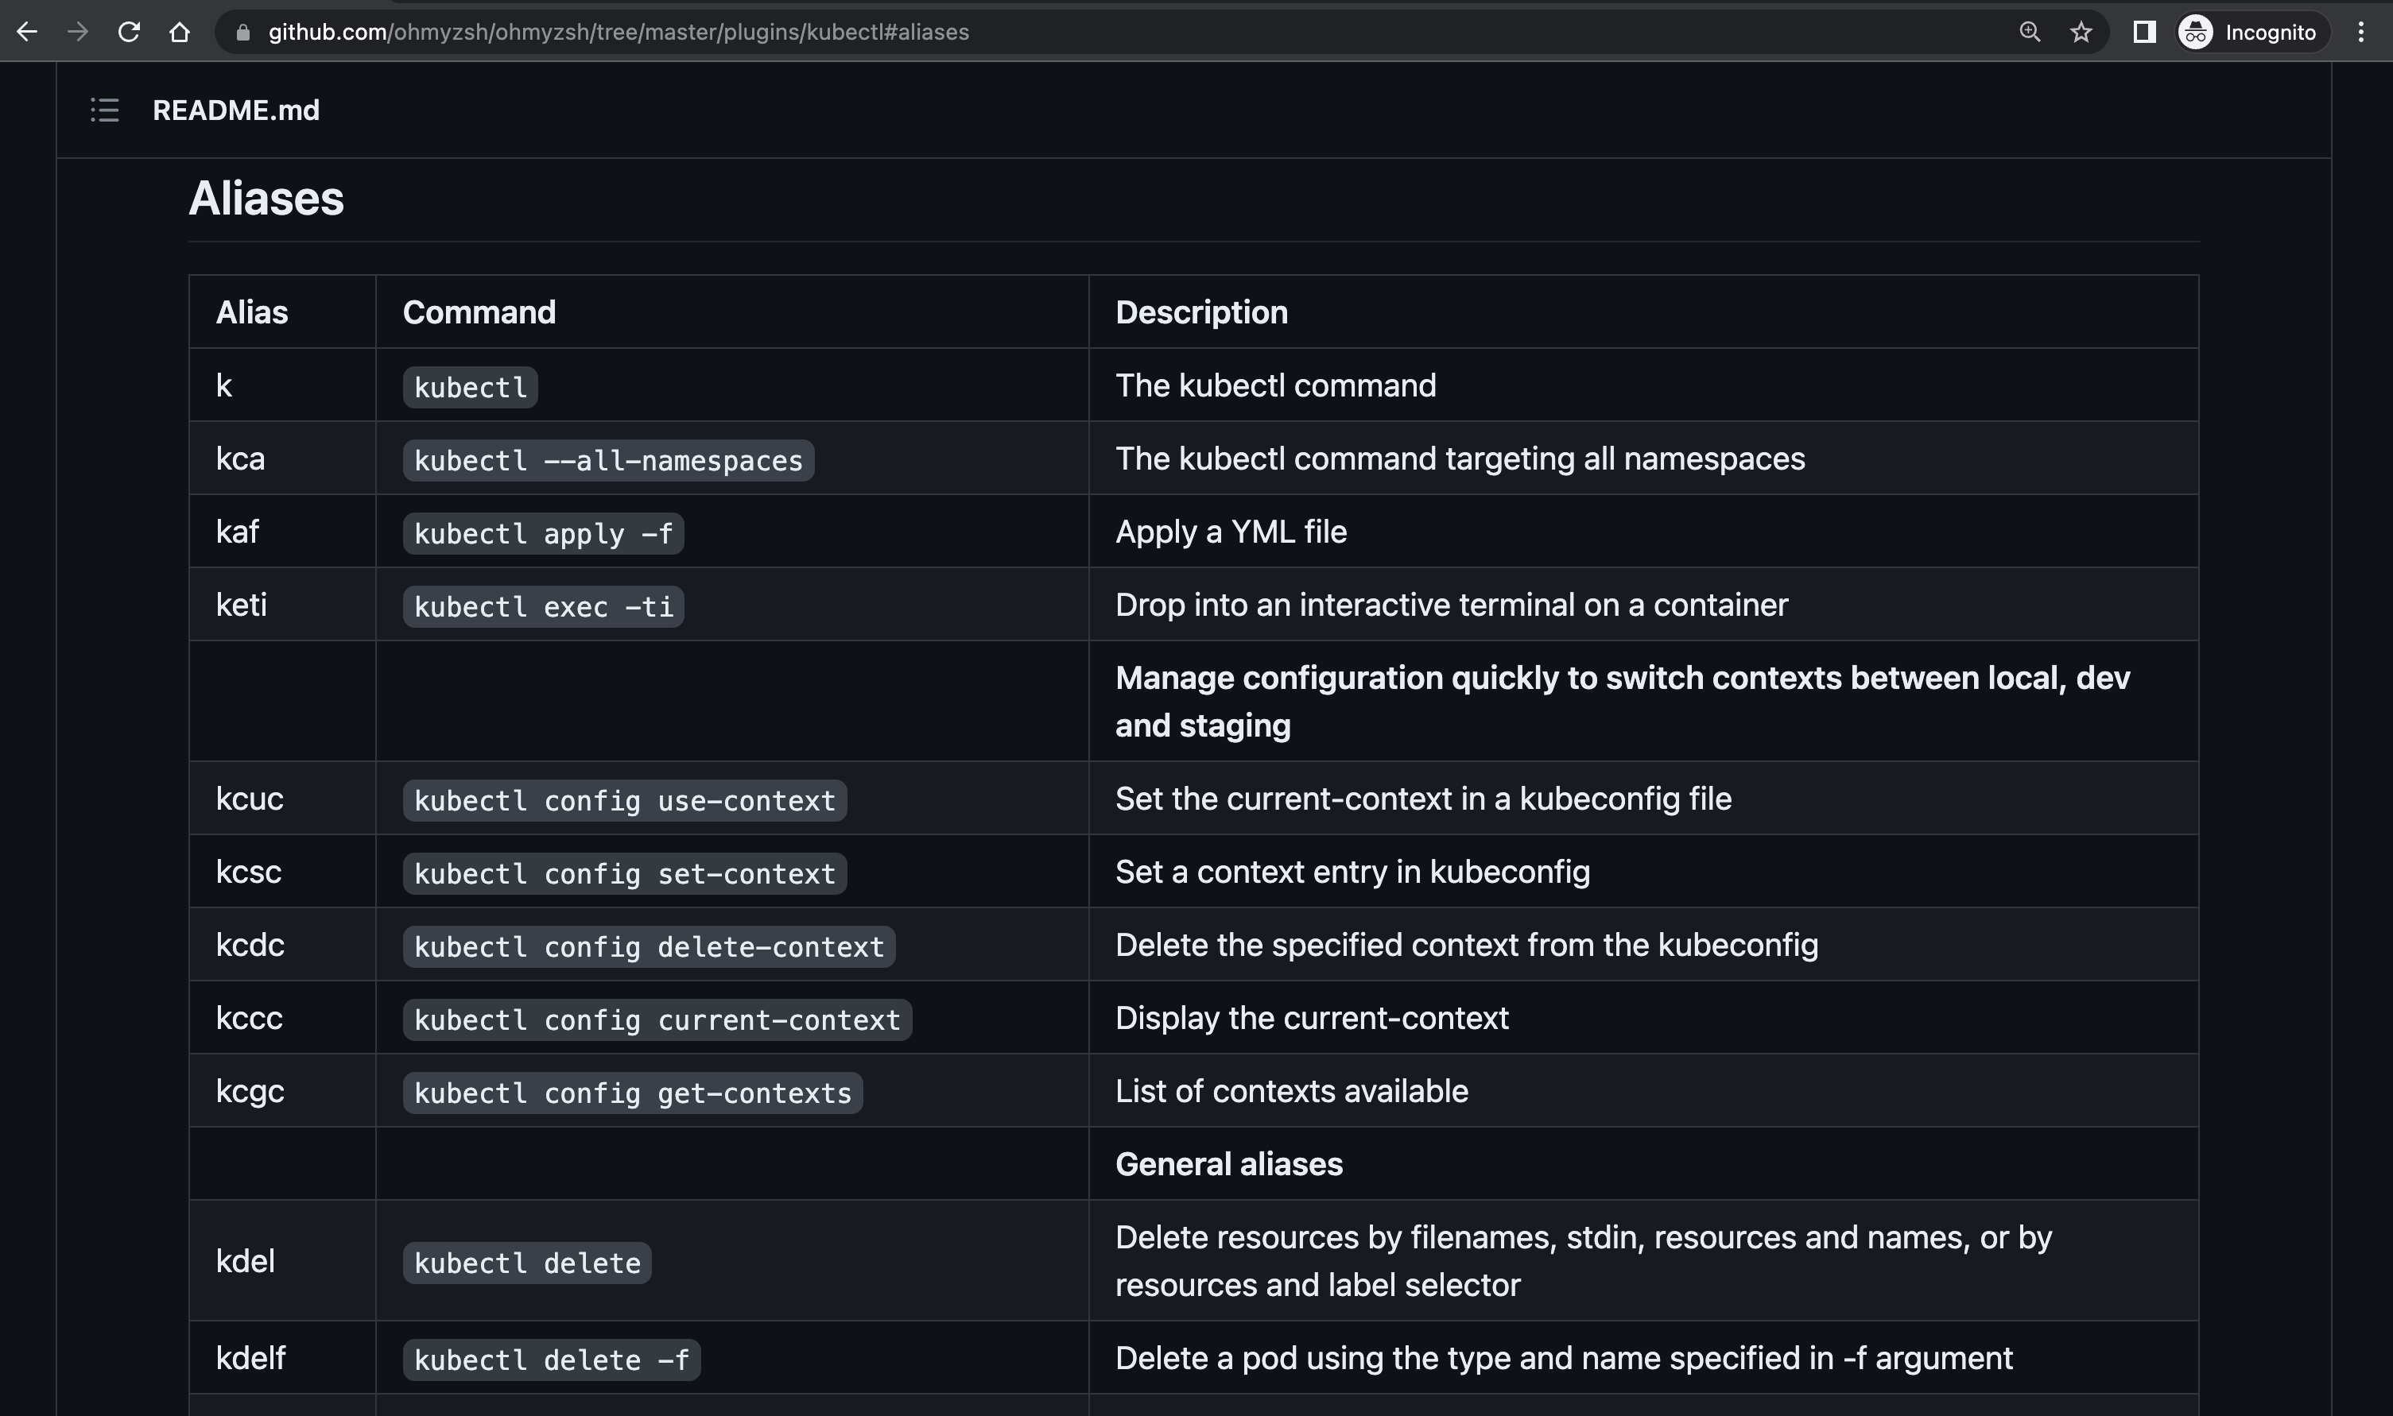
Thank you, aliases and plugins!
kubectl zsh plugin

Slide 5
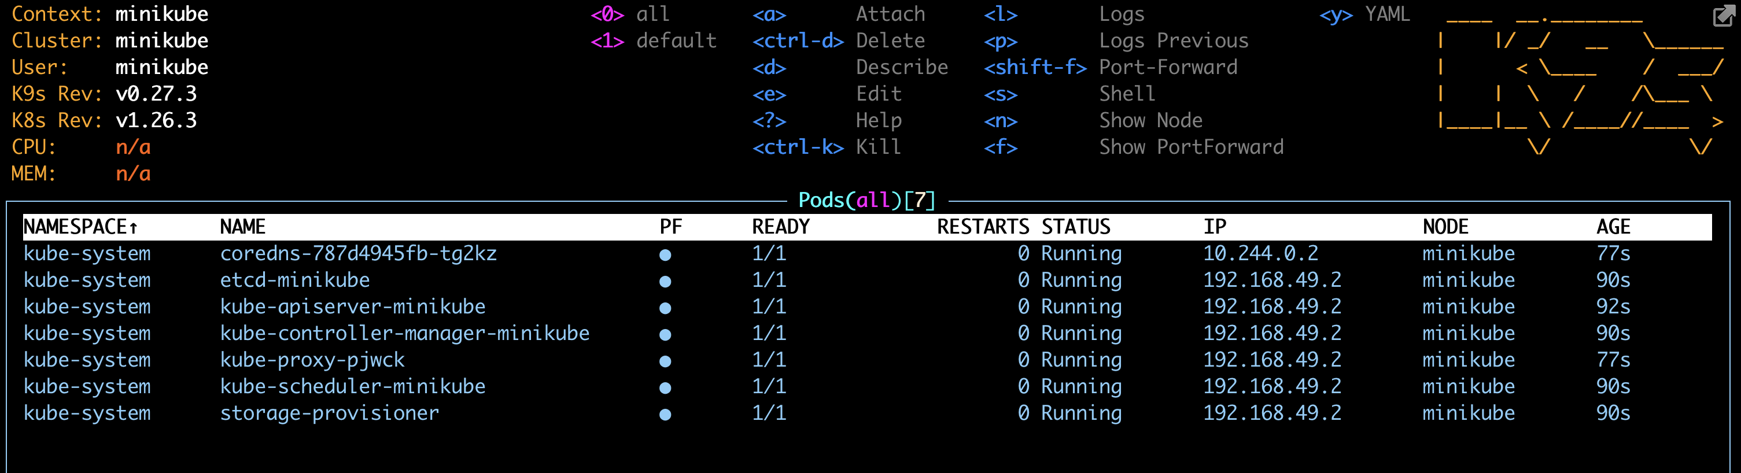
Oh.. My.. k9s!
"K9s is a terminal based UI to interact with your Kubernetes clusters”
k9scli.io github.com/derailed/k9s

Slide 6
Let's see it in action!

Slide 7
k9s cheat sheet
esc : resource-name = kubectl get resource-name
esc : po = kubectl get pods
0 = all namespaces
return or enter = see the container/s within a pod
s = exec into a container
l = log
f = full screen
w = wrap
shift + f = port-forward
y = see the object yaml
ctrl + d = delete an object
esc : sec = kubectl get secrets
x = decode a secret
esc : ns = kubectl get namespace
esc : deploy = kubectl get deployment
esc / = To filter rows and search for an item in the table
up or down arrow + Spacebar = Select/de-select multiple objects
s = scale Deployment, ReplicaSet etc
esc : ctx = kubectl config get-contexts - select a context and hit return to start using that context

Slide 8
Thank You!
@findarka
linkedin.com/in/findarka

